Slide 1
2D Video Game Animation Alex Shaffer

Slide 2
Mario

Slide 3
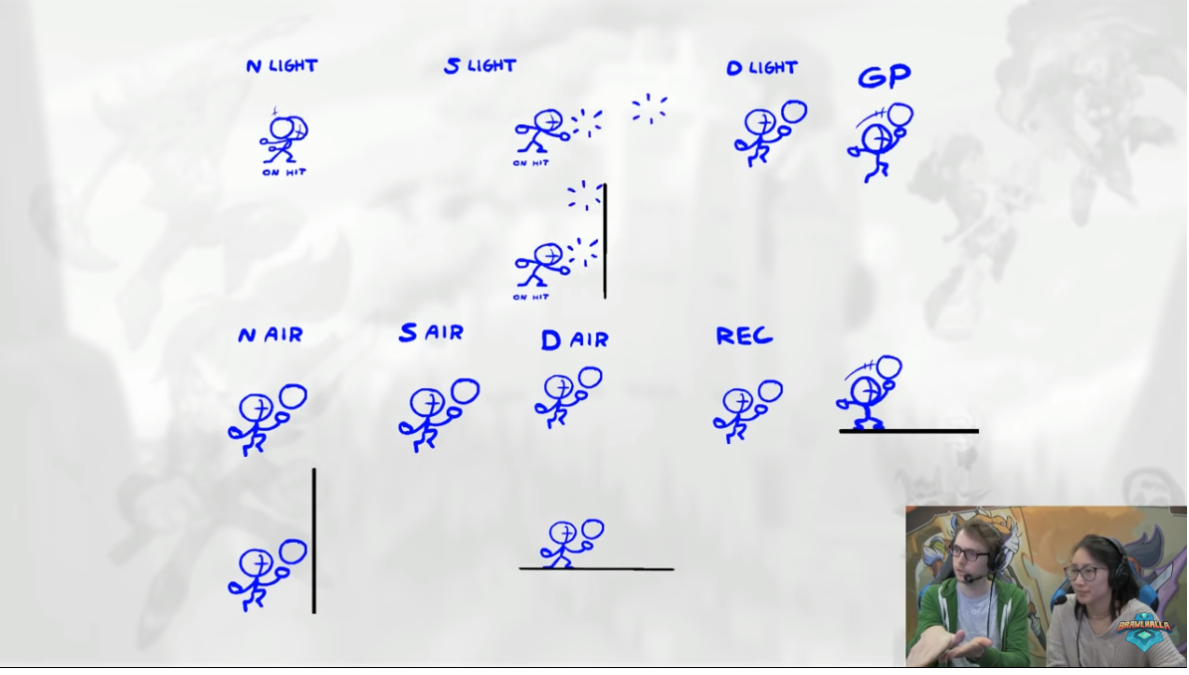
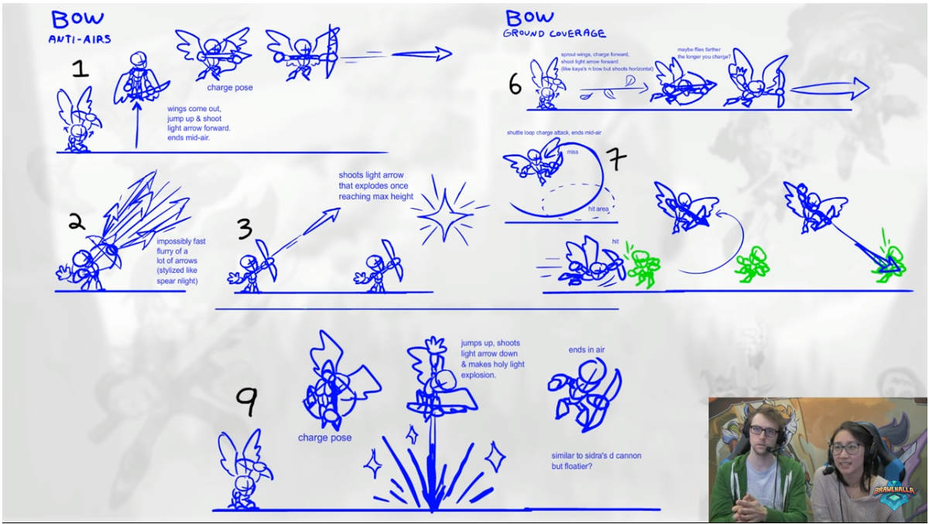
Brawlhalla

Slide 4
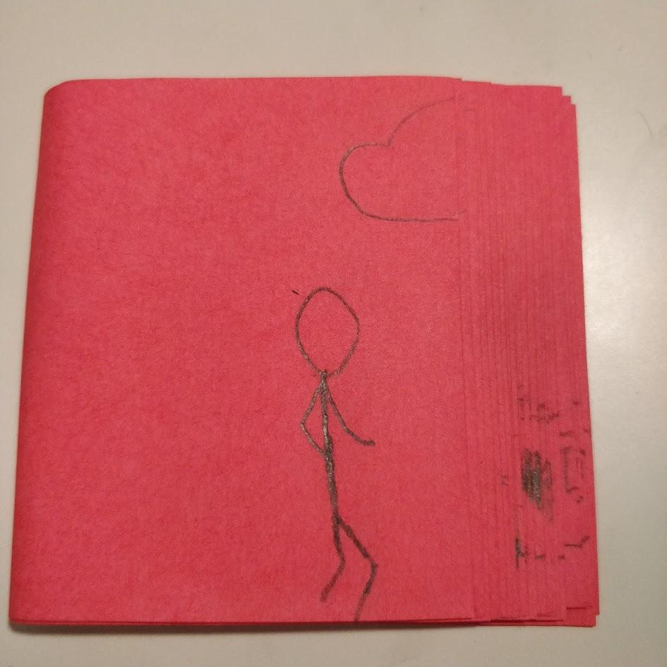
Flip Book
Draw each “Frame” of your flip book with the sticky
side of the post it note on the left.
Stack the post it notes first on top last on bottom, with a little bit of non-overlapping paper on the left.
Hold the left side together and flip through you book at whatever speed or framerate works best.

